Slide 1
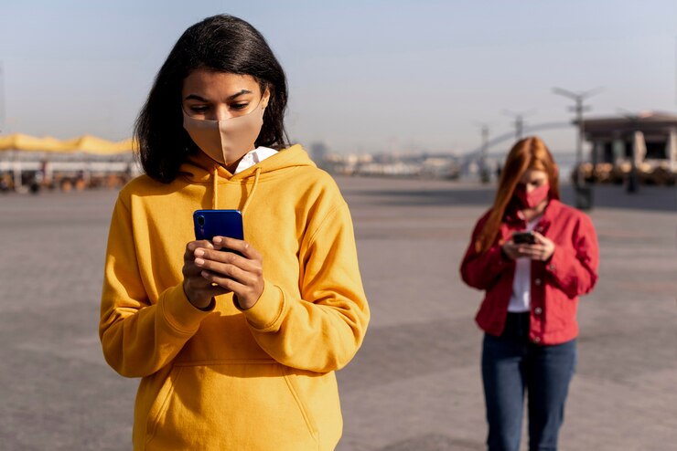
THE IMPACT OF SMARTPHONES
"How do smartphones impact our lives"

Slide 2
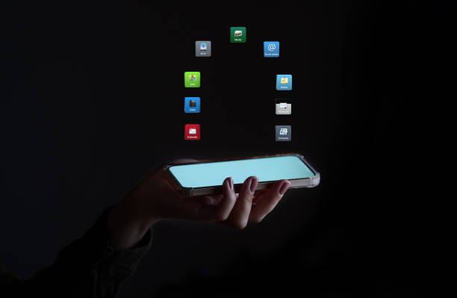
The key features about the impact of smartphones
✅ Positive Impacts
Improved Communication – Instant messaging, video calls, and social media enhance global connectivity.
Easy Access to Information – Internet access allows quick information retrieval anytime, anywhere.
Productivity and Learning – Apps and tools for education, work, and time management boost efficiency.
Navigation and Safety – GPS helps with travel and location tracking for safety and convenience.
Entertainment – Access to music, videos, games, and social media for leisure and relaxation.

Slide 3

⚠️ Negative Impacts
Addiction and Overuse – Excessive screen time can reduce focus and lead to phone dependency.
Mental Health Issues – Linked to anxiety, depression, low self-esteem, and sleep disruption.
Reduced Face-to-Face Interaction – Can weaken real-life relationships and social skills.
Health Concerns – Eye strain, neck pain, and sedentary behavior from prolonged use.
Privacy and Security Risks – Vulnerability to data leaks, scams, and cyber threats.

Slide 4
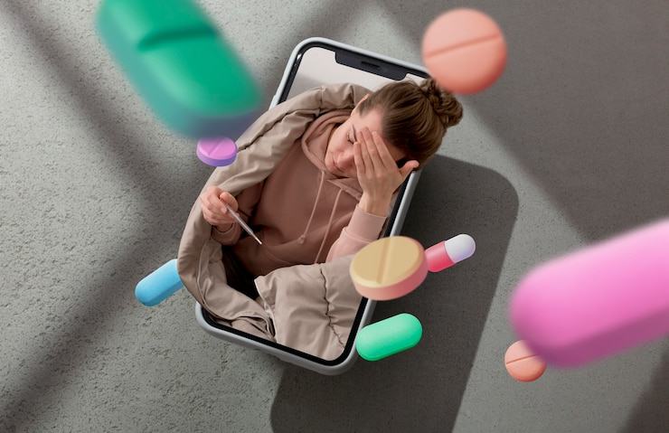
HEALTH EFFECTS OF SMARTPHONES:
Causes eyestrains and sleep disturbances
Leads to neck/back pain from poor posture
Increases Anxiety and stress
Reduces physical activity
Can cause smartphone Habit

Slide 5

✅ Tips for Healthy Smartphone Use:
Take regular screen breaks (20-20-20 rule).
Limit usage before bedtime.
Use blue light filters or night mode.
Practice good posture.
Set screen time limits or use tracking apps.

Slide 6
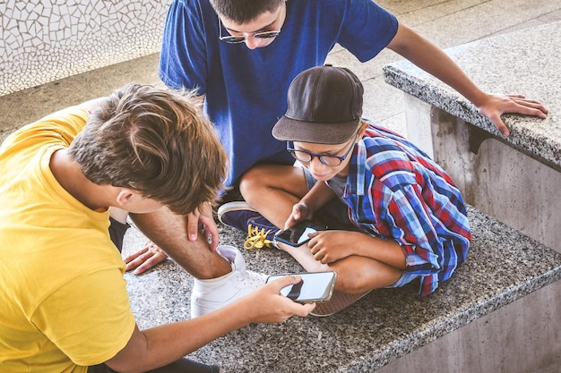
SMARTPHONES AND SOCIETY:
Global Connectivity: Instant communication worldwide.
Social Impact: Enhances connections, but may reduce real-life interaction.
Work Efficiency: Boosts productivity, blurs work-life boundaries.
Education Access: Facilitates learning, but can distract.
Privacy Concerns: Raises data and security issues.
Cultural Shift: Alters social values and behaviors.

Slide 7
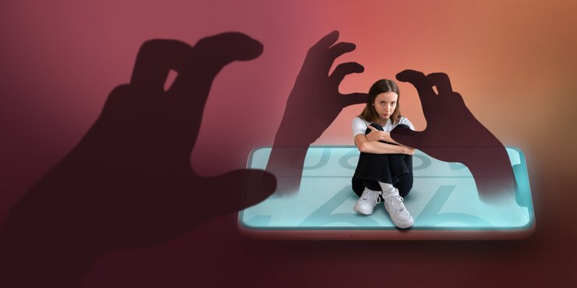
CONCLUSION
Smartphones have transformed society by enhancing communication, productivity, and access to information. However, excessive use can lead to health issues, social isolation, and privacy concerns. While they offer numerous benefits, mindful and balanced use is crucial to mitigate negative effects and maintain well-being.

Slide 8

QUESTION:
1.How have smartphones changed the way people communicate?
2.What are the positive effects of smartphones on education?
3.How do smartphones affect students’ concentration and academic performance?
4.In what ways can smartphones impact mental health?
5.Are smartphones making people more or less social?

Slide 9


